Slide 1

Relational Algebra

Slide 2

Outline
1
Selection and Projection
2
Union, intersection, and difference
3
Renaming
4
Cross-Product, Join and Division
5
Expression Tree and Introduction of Query Optimization

Slide 3

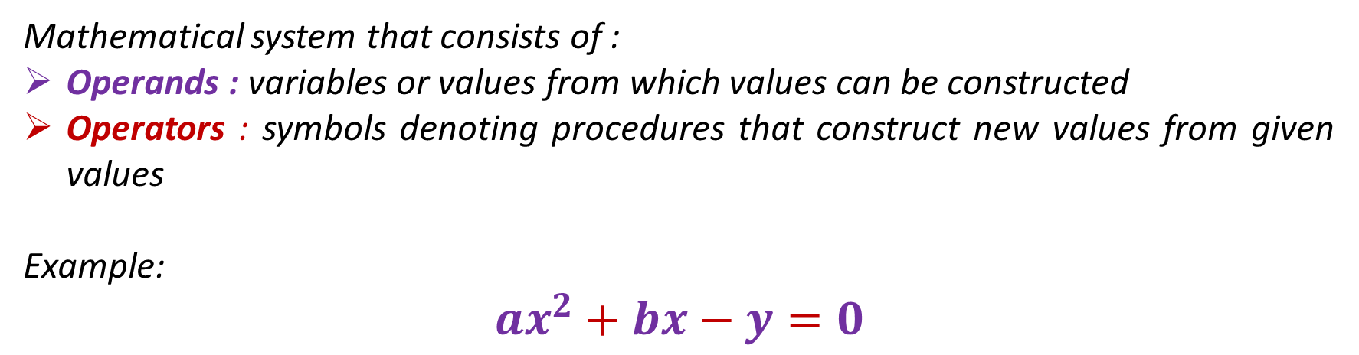
INTRO
ALGEBRA?
Mathematical system that consists of :
Operands : variables or values from which values can be constructed
Operators : symbols denoting procedures that construct new values from given values
Example:
$${ax}^{2}+bx−y=0$$
Notes:
In example, the red denotes operators and the purple denotes operands

Slide 4
INTRO
Relational Algebra : a formal query language
The relational algebra is important because:
It provides a formal foundation for relational model operations;
It is used as a basis for implementing and optimizing queries in the query processing and optimization modules that are integral parts of relational database management systems (RDBMS).
Relational Algebra consists of :
Basic Operator (selection, projection, union, intersect, difference, cross-product)
Additional Operator (renaming, join, division)

Slide 5
SELECTION AND PROJECTION
1

Slide 6
SCHEMA
DataPasien
IDPasien | NoKTP | Nama Pasien
PS00006 | 3507254111940001 | Lidra Trifidya
PS00007 | 3606125204940003 | Yutika Amelia Effendi
Dokter
NID | KodePoli | Nama
D009 | P01 | Dr. Budikusnaedi
D0010 | P02 | Dr. Hariyanto Kusuma
D0011 | P02 | Dr. Sri Herianti
D0012 | P03 | Drg. Elvin Purwantari
Pemeriksaan
IDPeriksa | NID | IDPasien | TglPeriksa | Diagnosa
C001 | D009 | PS00006 | 01-Jan-15 | Radang Usus Buntu
C002 | D010 | PS00007 | 02-Jan-15 | Gigi Berlubang
C003 | D011 | PS00007 | 10-Feb-15 | Flu
C004 | D019 | PS00007 | 02-May-15 | Radang Usus Buntu

Slide 7

SELECTION
Selection operators : pick certain rows
$$T1 ≔ σ_{C} (T2)$$
$C$is a condition (as in “if” statements) that refers to attributes of $T2$
$T1$ is all those tuples of $T2$ that satisfy $C$

Slide 8
SELECTION
Example 1 : A patient who has IDPasien PS00006
$$σ_{IDPasien=`PS00006`}(DataPasien)$$
Result:
DataPasien
IDPasien | NoKTP | Nama Pasien
PS00006 | 3507254111940001 | Lidra Trifidya

Slide 9
SELECTION
Example 2 : Patients who are handled by a doctor with NID D009 on 01 January 2015
$$σ_{NID=`D009` ∧ TglPeriksa=`01−Jan−15`}(Pemeriksaan)$$
Result:
Pemeriksaan
IDPeriksa | NID | IDPasien | TglPeriksa | Diagnosa
C001 | D009 | PS00006 | 01-Jan-15 | Radang Usus Buntu

Slide 10

PROJECTION
Projection operators : pick certain columns
$$T1 ≔ π_{C} (T2)$$
$C$ is a list of attributes from the schema of $T2$
$T1$ is constructed by looking at each tuple of $T2$ , extracting the attributes on list $C$ , L , in the order specified, and creating from those components a tuple for $T1$

Slide 11
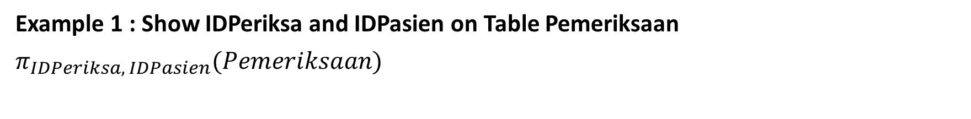
PROJECTION
Example 1 : Show IDPeriksa and IDPasien on Table Pemeriksaan
$$π_{IDPeriksa, IDPasien}(Pemeriksaan)$$
Result:
Pemeriksaan
IDPeriksa | IDPasien
C001 | PS00006
C002 | PS00007
C003 | PS00007
C004 | PS00007

Slide 12
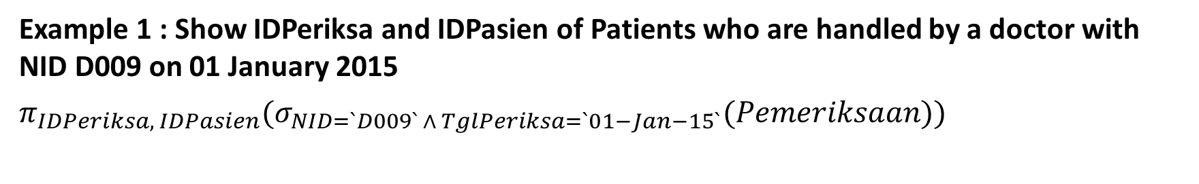
SELECTION AND PROJECTION
Example 1 : Show IDPeriksa and IDPasien of Patients who are handled by a doctor with NID D009 on 01 January 2015
$$π_{IDPeriksa, IDPasien}(σ_{NID=`D009` ∧ TglPeriksa=`01−Jan−15`}(Pemeriksaan))$$
Result:
Pemeriksaan
IDPeriksa | IDPasien
C001 | PS00006

Slide 13
UNION, INTERSECTION, AND DIFFERENTS
2

Slide 14
UNION, INTERSECTION, DIFFERENT
Union: R∪ S returns a relation instance containing all tuples that occur in either relation instance R or relation instance S (or both)
Intersection: R∩S returns a relation instance containing all tuples that occur in both R and S
Set-difference: R−S returns a relation instance containing all tuples that occur in R but not in S.

Slide 15
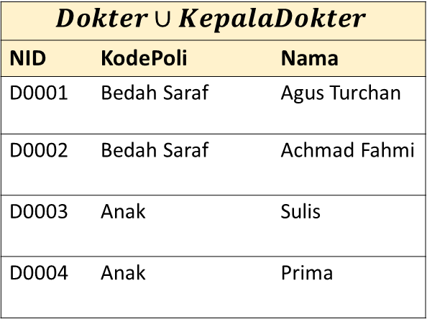
UNION, INTERSECTION, DIFFERENT
Union
Dokter
NID | KodePoli | Nama
D0001 | Bedah Saraf | Agus Turchan
D0002 | Bedah Saraf | Achmad Fahmi
D0003 | Anak | Sulis
D0004 | Anak | Prima
KepalaDokter
NID | KodePoli | Nama
D0001 | Bedah Saraf | Agus Turchan
D0003 | Anak | Sulis
$$Dokter∪KepalaDokter$$
NID | KodePoli | Nama
D0001 | Bedah Saraf | Agus Turchan
D0002 | Bedah Saraf | Achmad Fahmi
D0003 | Anak | Sulis
D0004 | Anak | Prima

Slide 16
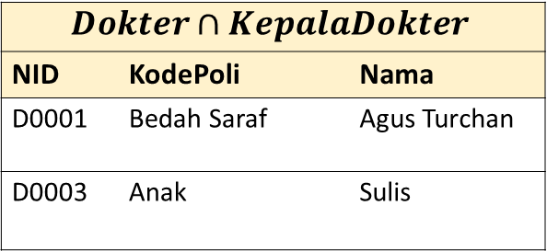
UNION, INTERSECTION, DIFFERENT
Intersection
Dokter
NID | KodePoli | Nama
D0001 | Bedah Saraf | Agus Turchan
D0002 | Bedah Saraf | Achmad Fahmi
D0003 | Anak | Sulis
D0004 | Anak | Prima
KepalaDokter
NID | KodePoli | Nama
D0001 | Bedah Saraf | Agus Turchan
D0003 | Anak | Sulis
$$Dokter∩KepalaDokter$$
NID | KodePoli | Nama
D0001 | Bedah Saraf | Agus Turchan
D0003 | Anak | Sulis

Slide 17
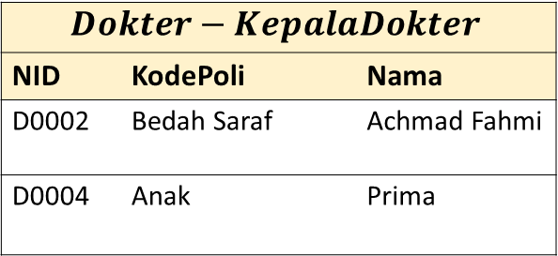
UNION, INTERSECTION, DIFFERENT
Set-Difference
Dokter
NID | KodePoli | Nama
D0001 | Bedah Saraf | Agus Turchan
D0002 | Bedah Saraf | Achmad Fahmi
D0003 | Anak | Sulis
D0004 | Anak | Prima
KepalaDokter
NID | KodePoli | Nama
D0001 | Bedah Saraf | Agus Turchan
D0003 | Anak | Sulis
$$Dokter−KepalaDokter$$
NID | KodePoli | Nama
D0002 | Bedah Saraf | Achmad Fahmi
D0004 | Anak | Prima

Slide 18
RENAMING
3

Slide 19
SCHEMA
DataPasien
IDPasien | NoKTP | Nama Pasien
PS00006 | 3507254111940001 | Lidra Trifidya
PS00007 | 3606125204940003 | Yutika Amelia Effendi
Dokter
NID | KodePoli | Nama
D009 | P01 | Dr. Budikusnaedi
D0010 | P02 | Dr. Hariyanto Kusuma
D0011 | P02 | Dr. Sri Herianti
D0012 | P03 | Drg. Elvin Purwantari
Pemeriksaan
IDPeriksa | NID | IDPasien | TglPeriksa | Diagnosa
C001 | D009 | PS00006 | 01-Jan-15 | Radang Usus Buntu
C002 | D010 | PS00007 | 02-Jan-15 | Gigi Berlubang
C003 | D011 | PS00007 | 10-Feb-15 | Flu
C004 | D019 | PS00007 | 02-May-15 | Radang Usus Buntu

Slide 20
SCHEMA
Dokter
NID | KodePoli | Nama
D009 | P01 | Dr. Budikusnaedi
D0010 | P02 | Dr. Hariyanto Kusuma
D0011 | P02 | Dr. Sri Herianti
D0012 | P03 | Drg. Elvin Purwantari
Pemeriksaan
IDPeriksa | NID | IDPasien | TglPeriksa | Diagnosa
C001 | D009 | PS00006 | 01-Jan-15 | Radang Usus Buntu
C002 | D010 | PS00007 | 02-Jan-15 | Gigi Berlubang
C003 | D011 | PS00007 | 10-Feb-15 | Flu
C004 | D019 | PS00007 | 02-May-15 | Radang Usus Buntu
 |  |  | Dokter |x| Pemeriksaan ====> Dokter.NID = Pemeriksaan.NID
NID | KodePoli | Nama | IDPeriksa | NID | IDPasien | TglPeriksa | Diagnosa
D009 | P01 | Dr. Budikusnaedi | C001 | D009 | PS00006 | 01-Jan-15 | Radang Usus Buntu
D010 | P02 | Dr. Hariyanto Kusuma | C002 | D010 | PS00007 | 02-Jan-15 | Gigi Berlubang
D011 | P02 | Dr. Sri Herianti | C003 | D011 | PS00007 | 10-Feb-15 | Flu

Slide 21

RENAMING
Renaming operators : changes attribute names for a relation without changing any values.
There are two ways to express renaming:
$T1 ≔ ρ_{A_{1}→{Att}_{1},…,A_{n}→{Att}_{n}} \left(T2\right)$
$T1$ $≔$ $ρ \left(A_{1}→{Att}_{1},…,A_{n}→{Att}_{n}, T2\right)$
where $T1$ has attributes ${Att}_{1}$,…, ${Att}_{n}$ and the same tuples as $T2$

Slide 22

RENAMING
Renaming tables : changes the name of table
$$\text{There} \text{are} \text{two} \text{ways} \text{to} \text{express} \text{renaming}\text{: }$$
$T1 ≔ ρ_{D} \left(T2\right)$
$T1 ≔ ρ \left(D, T2\right)$
$\text{where} T1$is a table $T2$ whose name is changed to $D$

Slide 23
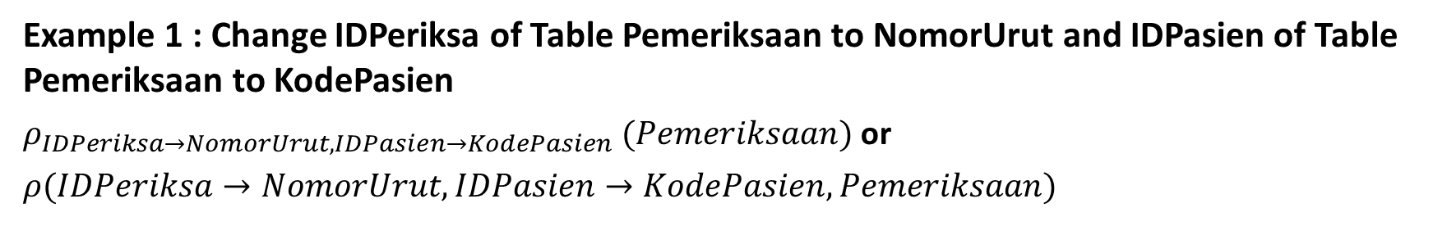
RENAMING
Example 1 : Change IDPeriksa of Table Pemeriksaan to NomorUrut and IDPasien of Table Pemeriksaan to KodePasien
$ρ_{IDPeriksa→NomorUrut,IDPasien→KodePasien} (Pemeriksaan)$ or
$$ρ(IDPeriksa→NomorUrut,IDPasien→KodePasien, Pemeriksaan)$$
Result:
Pemeriksaan
NomorUrut | NID | KodePasien | TglPeriksa | Diagnosa
C001 | D009 | PS00006 | 01-Jan-15 | Radang Usus Buntu
C002 | D010 | PS00007 | 02-Jan-15 | Gigi Berlubang
C003 | D011 | PS00007 | 10-Feb-15 | Flu
C004 | D019 | PS00007 | 02-May-15 | Radang Usus Buntu

Slide 24
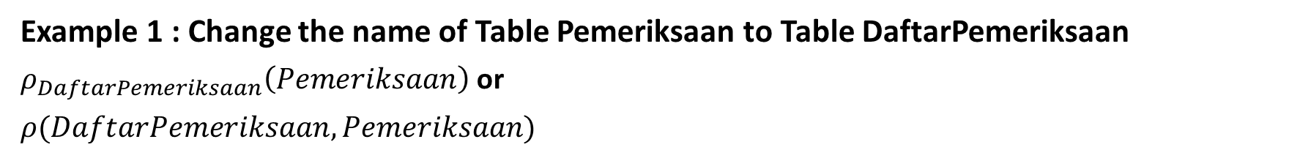
RENAMING
Example 1 : Change the name of Table Pemeriksaan to Table DaftarPemeriksaan
$$ρ_{DaftarPemeriksaan}\left(Pemeriksaan\right) \text{or}$$
$$ρ(DaftarPemeriksaan, Pemeriksaan)$$
Result:
DaftarPemeriksaan
IDPeriksa | NID | IDPasien | TglPeriksa | Diagnosa
C001 | D009 | PS00006 | 01-Jan-15 | Radang Usus Buntu
C002 | D010 | PS00007 | 02-Jan-15 | Gigi Berlubang
C003 | D011 | PS00007 | 10-Feb-15 | Flu
C004 | D019 | PS00007 | 02-May-15 | Radang Usus Buntu

Slide 25
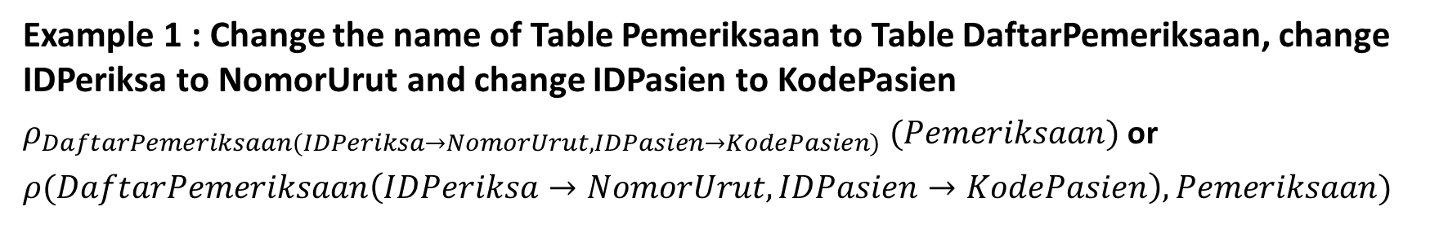
RENAMING
Example 1 : Change the name of Table Pemeriksaan to Table DaftarPemeriksaan, change IDPeriksa to NomorUrut and change IDPasien to KodePasien
$ρ_{DaftarPemeriksaan(IDPeriksa→NomorUrut,IDPasien→KodePasien)} (Pemeriksaan)$ or
$$ρ(DaftarPemeriksaan\left(IDPeriksa→NomorUrut,IDPasien→KodePasien\right), Pemeriksaan)$$
Result:
DaftarPemeriksaan
NomorUrut | NID | KodePasien | TglPeriksa | Diagnosa
C001 | D009 | PS00006 | 01-Jan-15 | Radang Usus Buntu
C002 | D010 | PS00007 | 02-Jan-15 | Gigi Berlubang
C003 | D011 | PS00007 | 10-Feb-15 | Flu
C004 | D019 | PS00007 | 02-May-15 | Radang Usus Buntu

Slide 26
CROSS-PRODUCT, JOIN, AND DIVISIONS
4

Slide 27

CROSS-PRODUCT
Cross-Product operators : a relation instance whose schema contains all the fields of R (in the same order as they appear in R) followed by all the fields of S (in the same order as they appear in S)
$$R1 ≔R2 ×R3$$
$Pair each tuple of R3 with each tuple of R2.$
$Schema of R3is the attributes of R1and then R2, in order$

Slide 28
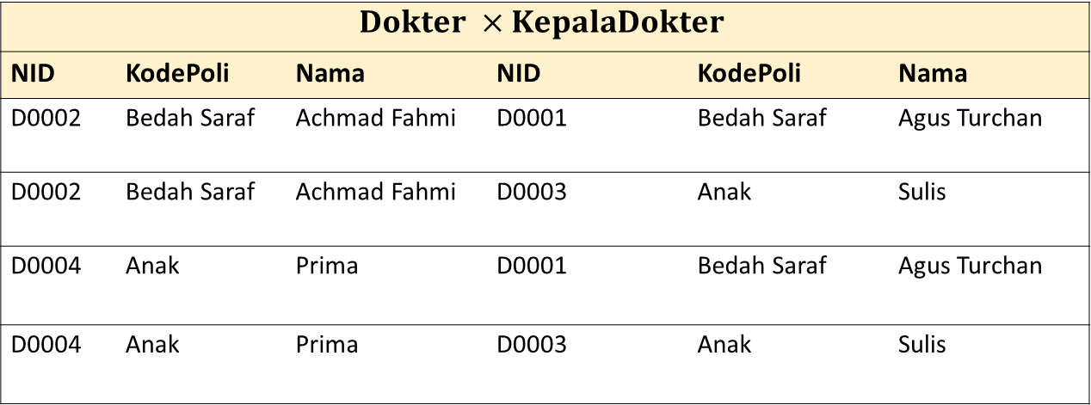
CROSS-PRODUCT
Dokter
NID | KodePoli | Nama
D0002 | Bedah Saraf | Achmad Fahmi
D0004 | Anak | Prima
KepalaDokter
NID | KodePoli | Nama
D0001 | Bedah Saraf | Agus Turchan
D0003 | Anak | Sulis
$$Dokter ×KepalaDokter$$
NID | KodePoli | Nama | NID | KodePoli | Nama
D0002 | Bedah Saraf | Achmad Fahmi | D0001 | Bedah Saraf | Agus Turchan
D0002 | Bedah Saraf | Achmad Fahmi | D0003 | Anak | Sulis
D0004 | Anak | Prima | D0001 | Bedah Saraf | Agus Turchan
D0004 | Anak | Prima | D0003 | Anak | Sulis

Slide 29
JOIN
Join combines information from two or more relations
Join is cross product operation, followed by selection and projection
Type of Join :
Theta-join (conditional join)
Natural join
Left Outer Join
Right Outer Join
Full Outer Join

Slide 30
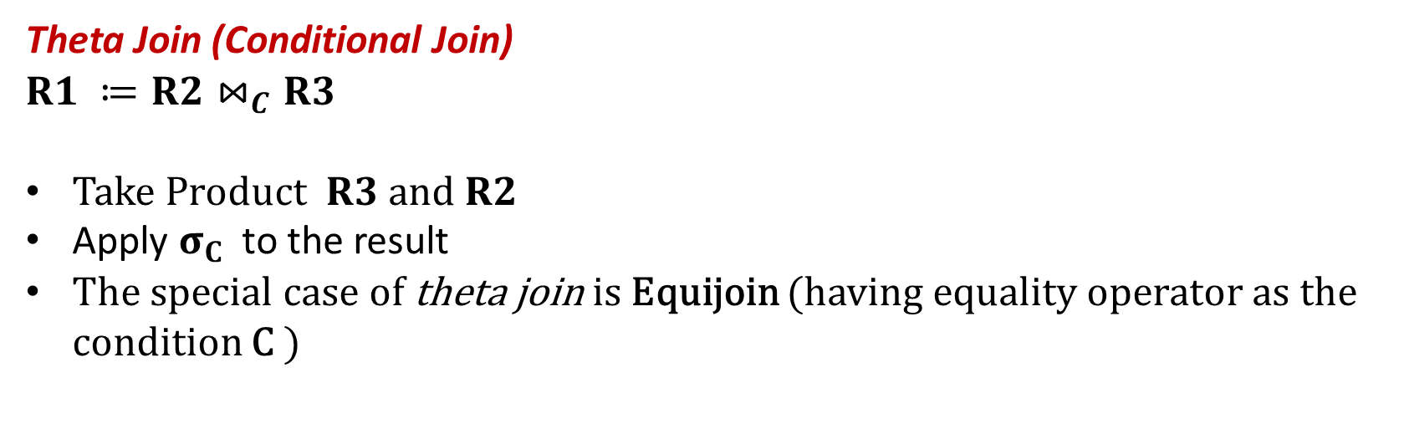
JOIN
Theta Join (Conditional Join)
$$R1 ≔R2⋈_{C}R3$$
$Take Product R3 and R2$
Apply $σ_{C}$ to the result
The special case of theta join is Equijoin (having equality operator as the condition C )

Slide 31
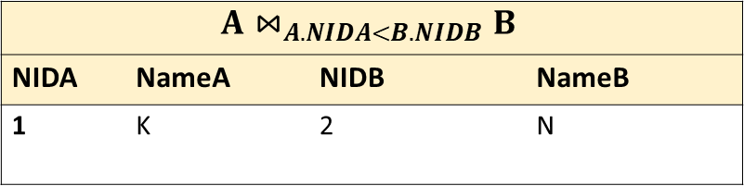
JOIN
Theta Join
A
NIDA | NameA
1 | K
5 | L
B
NIDB | NameB
1 | M
2 | N
$$A⋈_{A.NIDA<B.NIDB}B$$
NIDA | NameA | NIDB | NameB
1 | K | 2 | N

Slide 32
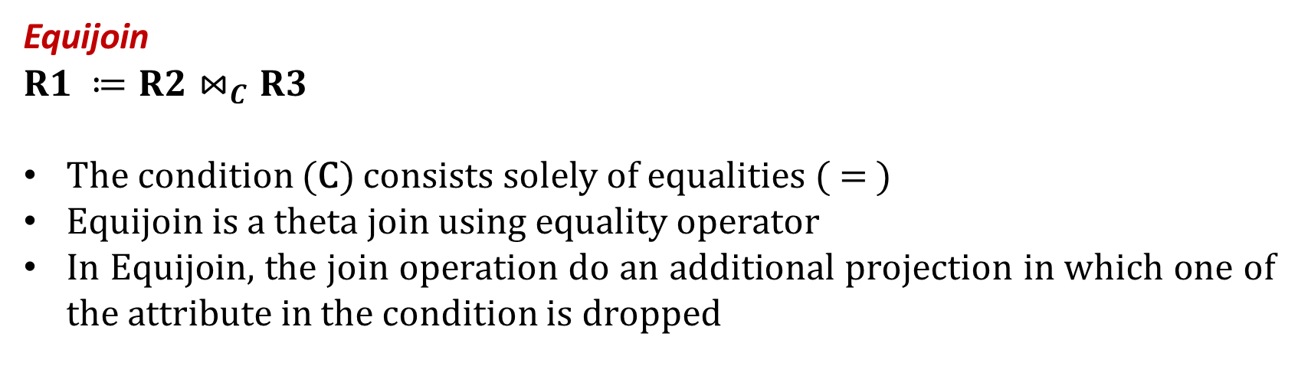
JOIN
Equijoin
$$R1 ≔R2⋈_{C}R3$$
The condition (C) consists solely of equalities ( = )
Equijoin is a theta join using equality operator
In Equijoin, the join operation do an additional projection in which one of the attribute in the condition is dropped

Slide 33
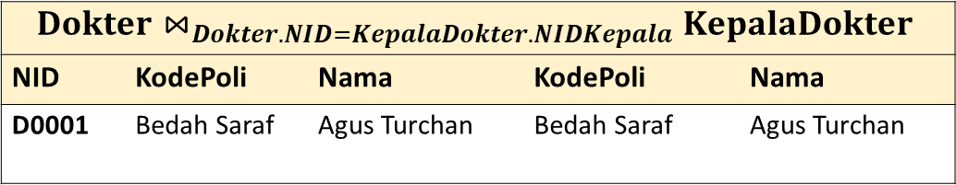
JOIN
Equijoin
Dokter
NID | KodePoli | Nama
D0001 | Bedah Saraf | Agus Turchan
D0004 | Anak | Prima
KepalaDokter
NIDKepala | KodePoli | Nama
D0001 | Bedah Saraf | Agus Turchan
D0003 | Anak | Sulis
$$Dokter⋈_{Dokter.NID=KepalaDokter.NIDKepala}KepalaDokter$$
NID | KodePoli | Nama | KodePoli | Nama
D0001 | Bedah Saraf | Agus Turchan | Bedah Saraf | Agus Turchan
Because of equijoin, only one of the attribute in the condition, i.e. Dokter.NID=KepalaDokter.NIDKepala, is chosen, so KepalaDokter.NIDKepala is projected out.

Slide 34

JOIN
Natural Join
A useful join variant ( natural join) connects two relations by:
Equating attributes of the same name, and
Projecting out one copy of each pair of equated attributes
$$R1 ≔R2 ⋈R3$$

Slide 35
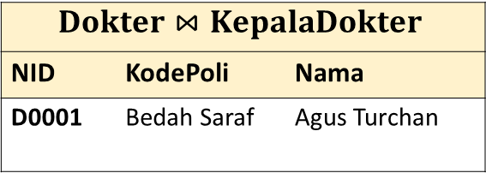
JOIN
KepalaDokter
NID
KodePoli
Nama
D0001
Bedah Saraf
Agus Turchan
D0003
Anak
Sulis
Natural Join
KepalaDokter
NID | KodePoli | Nama
D0001 | Bedah Saraf | Agus Turchan
D0003 | Anak | Sulis
Dokter
NID | KodePoli | Nama
D0001 | Bedah Saraf | Agus Turchan
D0004 | Anak | Prima
Dokter |x| KepalaDokter ==>Dokter.NID = KepalaDokter.NID
NID | KodePoli | Nama | NID | KodePoli | Nama
D0001 | Bedah Saraf | Agus Turchan | D0001 | Bedah Saraf | Agus Turchan
D0001 | Bedah Saraf | Agus Turchan | D0003 | Anak | Sulis
D0004 | Anak | Prima | D0001 | Bedah Saraf | Agus Turchan
D0004 | Anak | Prima | D0003 | Anak | Sulis
$$Dokter⋈KepalaDokter$$
NID | KodePoli | Nama
D0001 | Bedah Saraf | Agus Turchan
Because both of Table Dokter and Table KepalaDokter have same names of attributes, so only one NID, one KodePoli and one Nama are chosen.

Slide 36
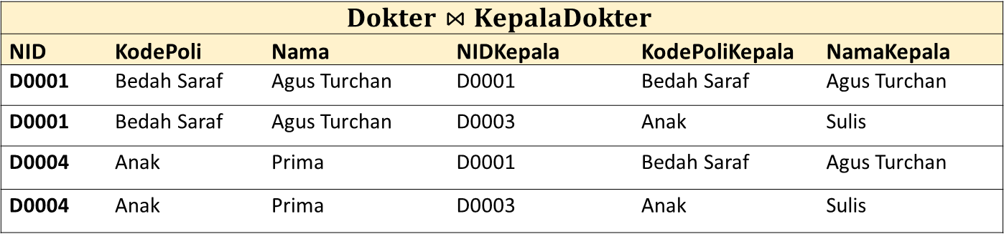
JOIN
Natural Join
Dokter
NID | KodePoli | Nama
D0001 | Bedah Saraf | Agus Turchan
D0004 | Anak | Prima
KepalaDokter
NIDKepala | KodePoliKepala | NamaKepala
D0001 | Bedah Saraf | Agus Turchan
D0003 | Anak | Sulis
$$Dokter⋈KepalaDokter$$
NID | KodePoli | Nama | NIDKepala | KodePoliKepala | NamaKepala
D0001 | Bedah Saraf | Agus Turchan | D0001 | Bedah Saraf | Agus Turchan
D0001 | Bedah Saraf | Agus Turchan | D0003 | Anak | Sulis
D0004 | Anak | Prima | D0001 | Bedah Saraf | Agus Turchan
D0004 | Anak | Prima | D0003 | Anak | Sulis
Because there is no equated attributes of Table Dokter and Table KepalaDokter, each tuple in Table Dokter is paired with each tuple in Table KepalaDokter (natural join becomes cross-product)

Slide 37

JOIN
Left Outer Join
It is left join in SQL
The relational algebra of left outer join is shown below.
$$R1 ≔R2 {\text{⟕}}_{C} R3$$

Slide 38
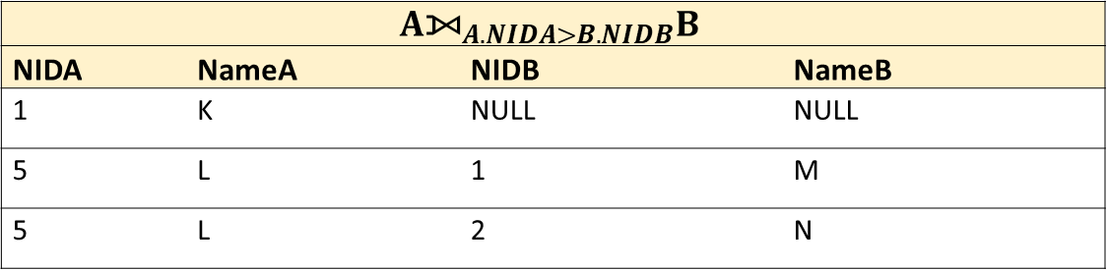
JOIN
Left Outer Join
A
NIDA | NameA
1 | K
5 | L
B
NIDB | NameB
1 | M
2 | N
$$A{\text{⟕}}_{A.NIDA>B.NIDB}B$$
NIDA | NameA | NIDB | NameB
1 | K | NULL | NULL
5 | L | 1 | M
5 | L | 2 | N

Slide 39

JOIN
Right Outer Join
It is right join in SQL
The relational algebra of left outer join is shown below.
$$R1 ≔R2 {\text{⟖}}_{C} R3$$

Slide 40
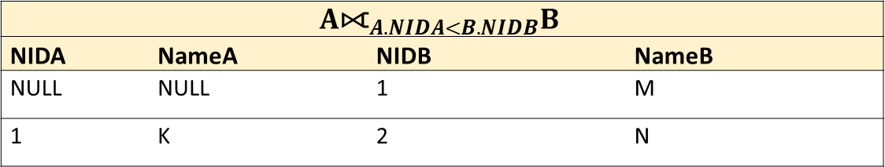
JOIN
Right Outer Join
A
NIDA | NameA
1 | K
5 | L
B
NIDB | NameB
1 | M
2 | N
$$A{\text{⟖}}_{A.NIDA<B.NIDB}B$$
NIDA | NameA | NIDB | NameB
NULL | NULL | 1 | M
1 | K | 2 | N

Slide 41

JOIN
Full Outer Join
It is full join in SQL
The relational algebra of left outer join is shown below.
$$R1 ≔R2 {\text{⟗}}_{C} R3$$

Slide 42
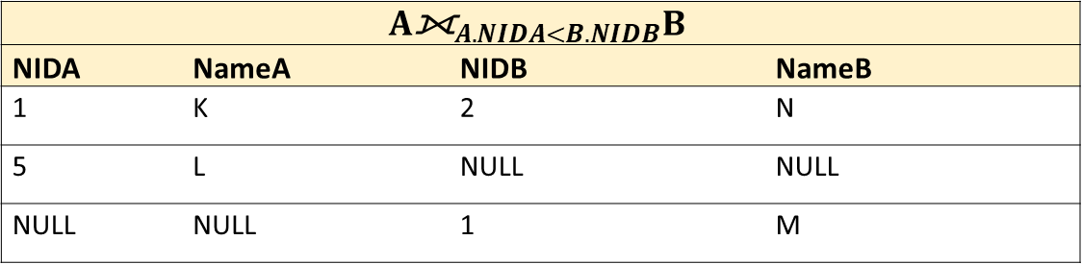
JOIN
Full Outer Join
A
NIDA | NameA
1 | K
5 | L
B
NIDB | NameB
1 | M
2 | N
$$A{\text{⟗}}_{A.NIDA<B.NIDB}B$$
NIDA | NameA | NIDB | NameB
1 | K | 2 | N
5 | L | NULL | NULL
NULL | NULL | 1 | M

Slide 43

DIVISION
Division
$$R1 ≔R2/R3$$
$All attributes in R3 \left(denominator\right) must also be presented in R2 (numerator)$
$R2 has some extra attributes$
The schema of the result relation $R1$ contains the attributes defined in $R2$ and not defined in $R3$

Slide 44
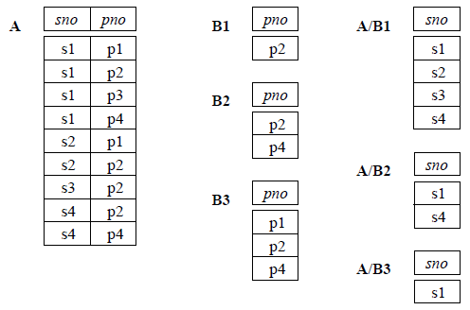
DIVISION
Division

Slide 45
EXPRESSION TREE AND INTRODUCTION OF QUERY OPTIMIZATION
5

Slide 46
EXPRESSION TREE
Leaves : can be called operands -- either variables standing for relations or particular, constant relations
Interior nodes : can be called operators -- applied to their child or children

Slide 47

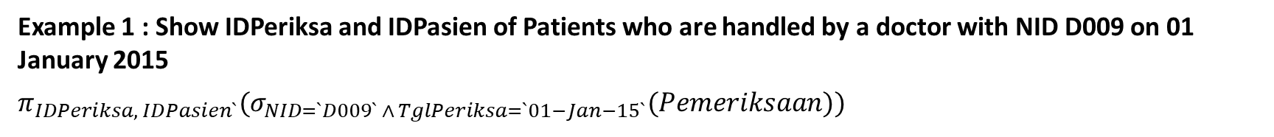


EXPRESSION TREE
Example 1 : Show IDPeriksa and IDPasien of Patients who are handled by a doctor with NID D009 on 01 January 2015
$$π_{IDPeriksa, IDPasien`}(σ_{NID=`D009` ∧ TglPeriksa=`01−Jan−15`}(Pemeriksaan))$$
$$π_{IDPeriksa, IDPasien}$$
$$σ_{NID=`D009` ∧ TglPeriksa=`01−Jan−15`}$$
$$Pemeriksaan$$

Slide 48







EXPRESSION TREE
Example 2 : Show ID of patient, name of patient, name of doctors and the check date on 01 January 2015
$$π_{NoKTP,Nama Pasien,Nama,TglPeriksa}(σ_{TglPeriksa=`01−Jan−15`}(Dokter⋈(DataPasien⋈Pemeriksaan)))$$
$$π_{NoKTP,Nama Pasien,Nama,TglPeriksa}$$
$$σ_{TglPeriksa=`01−Jan−15`}$$
$$⋈$$
$$Dokter$$
$$⋈$$
$$DataPasien$$
$$Pemeriksaan$$

Slide 49
















QUERY OPTIMIZATION
Relational Algebra can be used in query optimization by comparing the query with expression tree
Example: Show ID of patient, name of patient, name of doctors and the check date on 01 January 2015
1st Option
2nd Option
$$π_{NoKTP,Nama Pasien,Nama,TglPeriksa}$$
$$σ_{TglPeriksa=`01−Jan−15`}$$
$$σ_{TglPeriksa=`01−Jan−15`}$$
$$⋈$$
$$π_{NID,Nama}$$
$$⋈$$
$$⋈$$
$$Dokter$$
$$Dokter$$
$$⋈$$
$$π_{IDPasien,NoKTP,Nama Pasien}$$
$$π_{NID,IDPasien,TglCheck}$$
$$DataPasien$$
$$Pemeriksaan$$
$$DataPasien$$
$$Pemeriksaan$$
Notes:
Based on Option 1st and 2nd , the 2nd Option has better performance with 1st because 2nd specifies the columns before join, so the cost of join is smaller than 1st

Slide 50
EXERCISES
6

Slide 51
SCHEMA
DataPasien(IDPasien: string, NoKtp: string, Nama Pasien: string)
Dokter(NID: string, KodePoli: string, Nama: string)
Poli(KodePoli: string, NamaPoli: string)
Pemeriksaan(IDPeriksa: string, NID: string, IDPasien: string, TglPeriksa: date, Diagnosa: string)
IDPasien | NoKTP | Nama Pasien
PS00006 | 3507254111940001 | Lidra Trifidya
PS00007 | 3606125204940003 | Yutika Amelia Effendi
NID | KodePoli | Nama
D009 | P01 | Dr. Budikusnaedi
D010 | P02 | Dr. Hariyanto Kusuma
D011 | P02 | Dr. Sri Herianti
D012 | P03 | Dr. Elvin Purwantari
KodePoli | NamaPoli
P01 | Bedah Umum
P02 | Mulut
P03 | THT
IDPeriksa | NID | IDPasien | TglPeriksa | Diagnosa
C001 | D009 | PS00006 | 01-Jan-15 | Radang Usus Buntu
C002 | D010 | PS00007 | 02-Jan-15 | Gigi Berlubang
C003 | D011 | PS00007 | 10-Feb-15 | Flu
C004 | D009 | PS00007 | 02-May-15 | Radang Usus Buntu

Slide 52
Create the relational algebra, the expression tree and the table result
Select id of patient and check date of patient who got “Gigi Berlubang” or “Flu
Select KTP number and name of patients who checked on May
Select name of patients, name of doctors, the doctor’s poly, and check date of patients who handled by doctor Dr. Budikusnaedi
Notes:
Select a pair of doctors who are in the same poly (a pair cannot contain of same doctor)
Select patients who had been checked in all poly

Slide 53
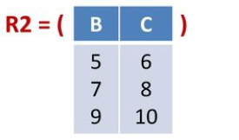
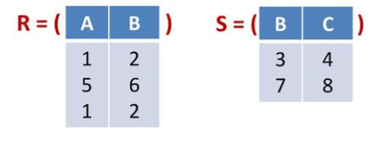

Fill the results of the questions based on the below tables
$σ_{A∗B>5}(R)$= …
$π_{C}(R2)$ = …
$R ×S= …$
$R⋈_{R.B<R2.C}R2$ = …
$π_{C} (S⋈\left(R⋈R2\right))$= …

